Slide 1


PEDIATRIC PULMONARY HYPERTENSION
Recent Updates & Indian Scenario!
MODERATOR:
MAITRI CHAUDHURI(MD, FNB)
EXPERTS:
MUNESH TOMAR (MD, FNB,FACC)
HETAL MEHTA (American board certified in pediatrics and pediatric cardiology)
Dedicated To Children Of India!

Slide 2
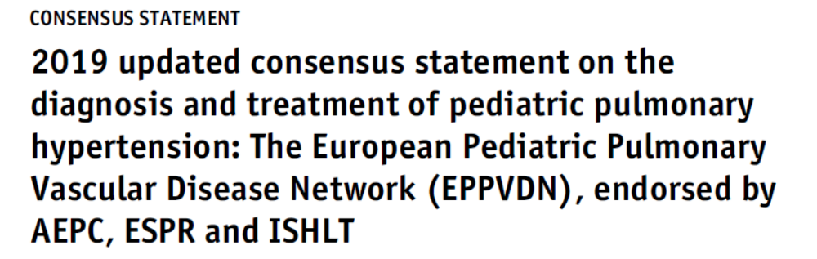
Pediatric PH – Underdiagnosed, Cryptic &The New Rays of Hope
Why Special?
Subtle Symptoms
Multiple Aetiologies
Late Referrals and Diagnosis
Treatment Extrapolated From Adults
Multi-disciplinary Teamwork
Right Heart Cath not always feasible
Uncorrected ,5 yr survival 60-75%.
Notes:
Dr Maitri

Slide 3
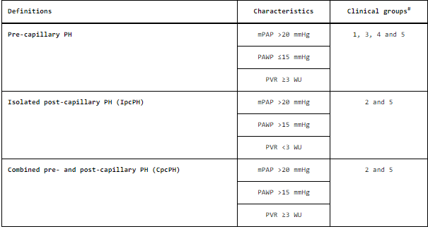
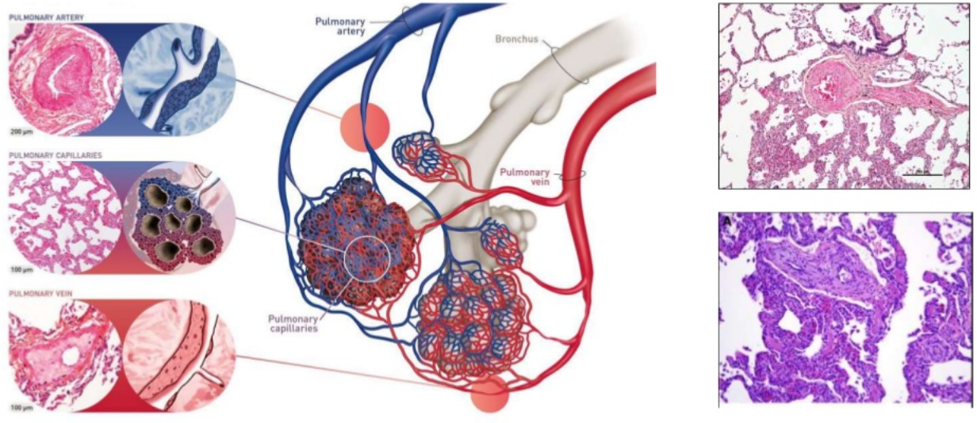
Valid from Age ≥ 3 Mo
2018 Latest Classification, NICE
Define PAH
Change : Cut Off of ↑ Mean PAP
Reduced From 25 to 20 mm Hg
20-24 is grey zone
Remember Echo Usually Tells
PA Systolic Pressure
Normal mean PAP = 14.8 ± 2 SD
Notes:
Dr maitri

Slide 4
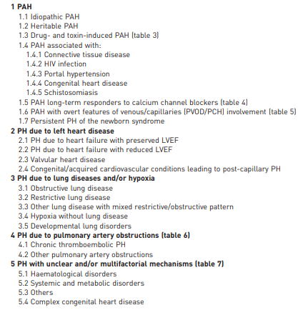
6th World Symposium on PAH, NICE, 2018
A. Most Common Causes in Children :
Cardiac
Lung (eg BPD, CDH, Hypoplastic)
B. Distinguish whether Transient Or Permanent
C. Pl. Focus on the RV , The End -Organ
Notes:
Dr Munesh/ maitri

Slide 5
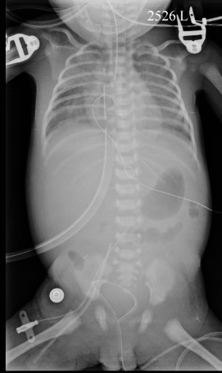
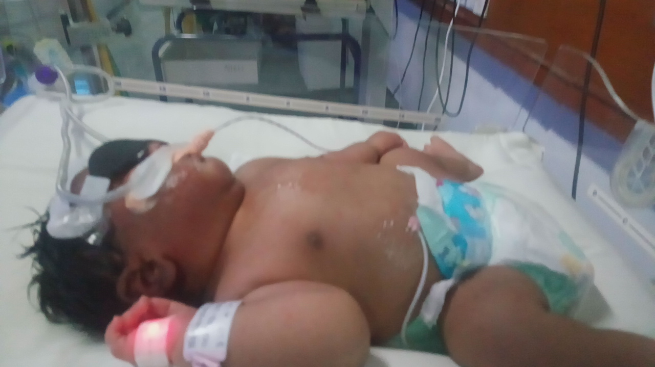
CASE # 1
2 Days Newborn, Term, LSCS
Infant of Diabetic Mother(HbA1c=9)
Weight 3.9 Kg, MAS +, NST +ve
Respiratory Distress from Birth
Pre& Post ductal Sats -76%
Notes:
Dr Maitri

Slide 6
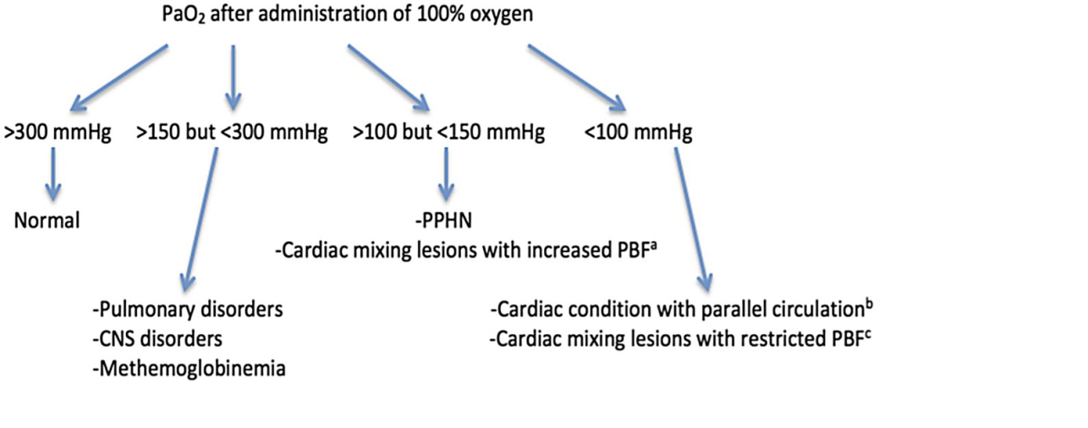
Possibilities:
HYPEROXIA TEST
PPHN
Cardiac
Respiratory
Sepsis
If there is no ABG Machine,
Use a Pulse Oximeter
Notes:
Dr Hetal : PPHN : Untreated mortality rate 10-30%(Cochrane Database 2017)

Slide 7
A,B,C ………. As per NRP/NALS
CXR : Cardiomegaly, Hazy Lungs, Comment On Pulmonary Vascularity
Hypoglycemia, Hypothermia, Metabolic Correction
Think About the operative hemodynamics from all angles
Head box /HFNC not adequate Here , Mechanical Ventilation Required
Keep an eye on vitals and color of baby, Pre-ductal & Post –Ductal Sats Difference <5-6%
? Surfactant, Next What
Notes:
Dr Munesh

Slide 8
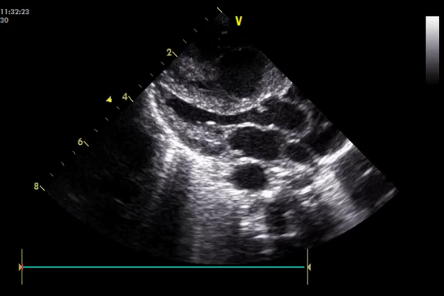
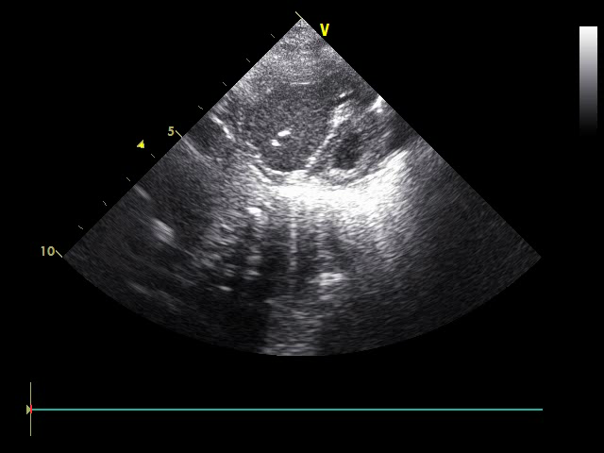
Functional Echocardiography in 1st Hospital
Within 6 Hrs
RV
RV
LV
LV
Midline IVS, D Shaped LV
Notes:
Dr Maitri

Slide 9
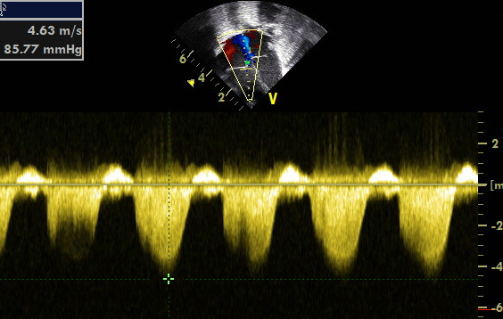
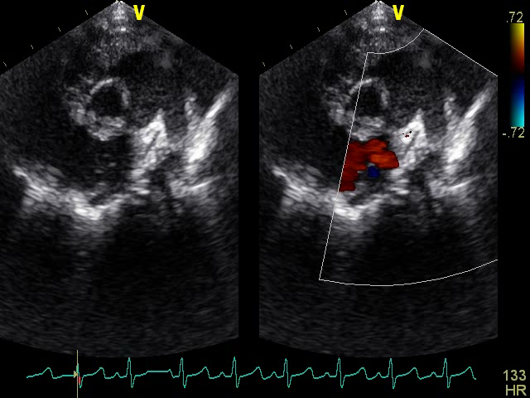
Severe PH , PA Systolic Pressure =85mm Hg, Mean BP =40 mm Hg
Suprasystemic PAH , PDA R>Lshunt
Notes:
Dr Maitri

Slide 10
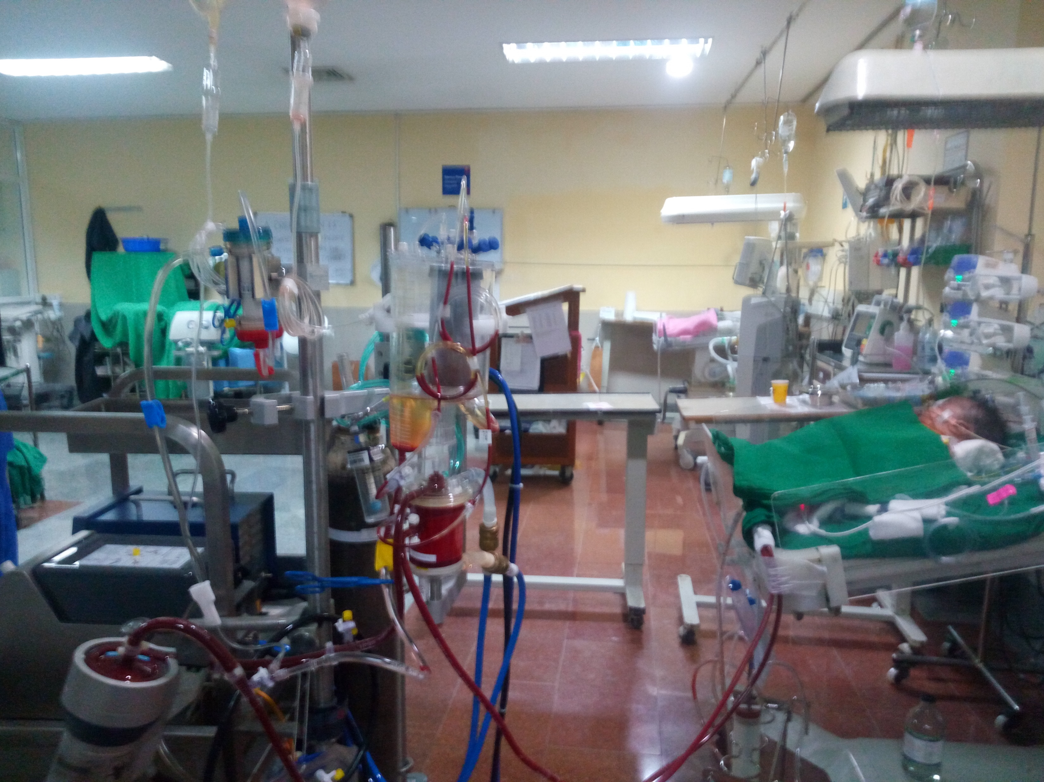
What Next?
Cheaper Alternatives: A,B,C(PIP/PEEP)
1. IV Sildenafil (if LVEF normal, normotensive)
2. IV Dobutamine
3. IV Milrinone
4. Avoid hypoxia, acidosis
5. Minimal Handling, Minimal Pain to Baby
6. NTG nebulization @25-50 mcg/kg /min for 10 Minutes
Tertiary NICU Limited In India
High Frequency Oscillatory Ventilation
Inhaled Nitric Oxide
Notes:
Dr Hetal 12.5 mg in 10 ml, cost =1800/ Sildenafil. Duration of action of inhaled NTG is 20-30 Minutes. Use the time for set up of iNO etc.

Slide 11
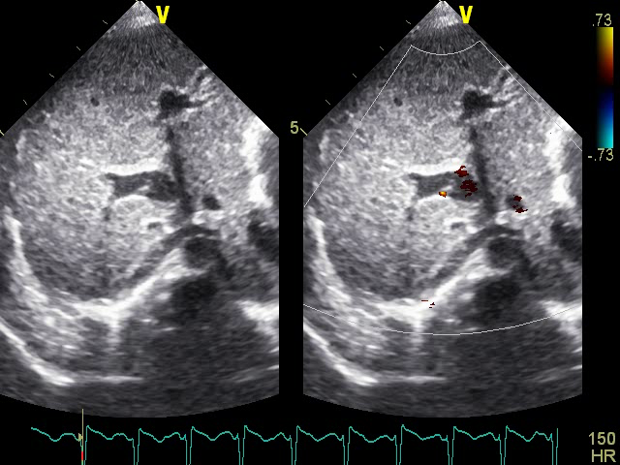
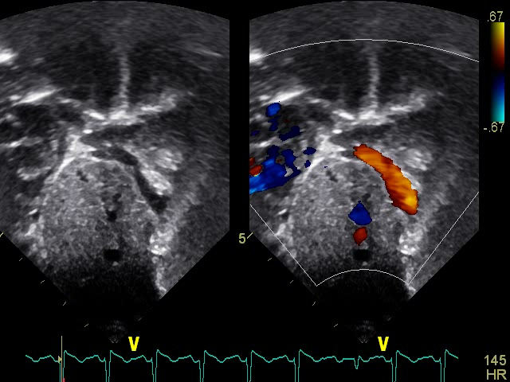
Review Echo Segment by Segment
~ Infracardiac TAPVC
Portal Vein
Always Exclude Heart Disease in PPHN Neonates
Management: emergency cardiac surgery!
Notes:
Dr Maitri Echo. Dr Hetal : Retrospectively : do you think sildenafil was a good choice?

Slide 12
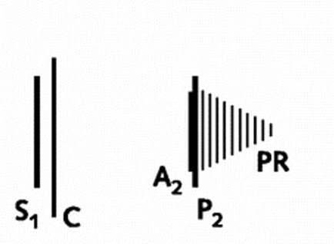
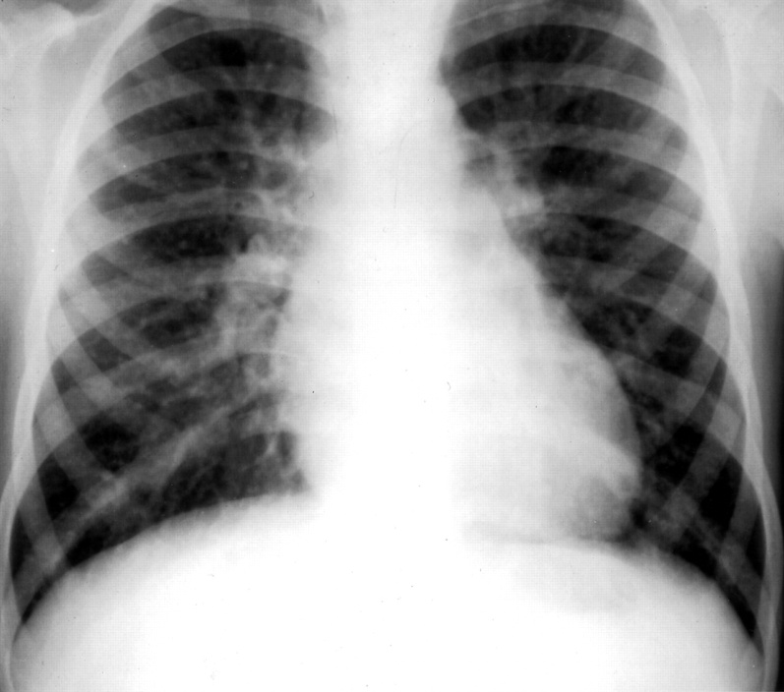

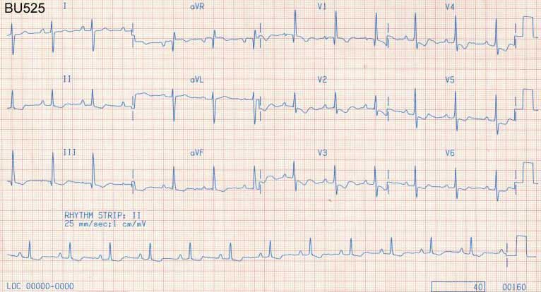
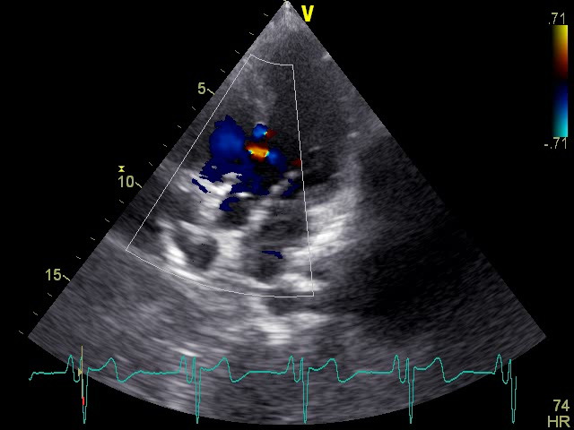
CASE # 2
17 Y F, VSD Diagnosed at 6 Mo
Notes:
Dr Maitri

Slide 13
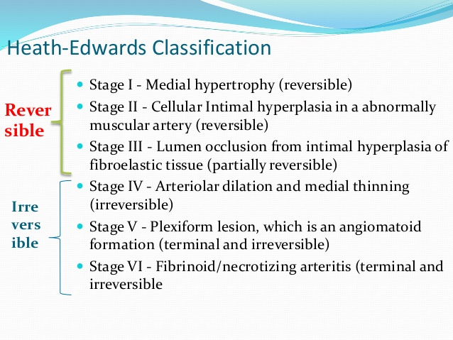
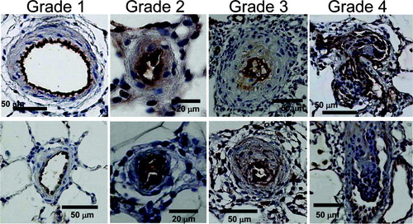
TOO LATE , STRIKE THE IRON ONLY WHEN HOT”
Pulmonary Hypertensive Vascular Disease/
Pulmonary Vascular Occlusive Disease
Regular Ped cardio FU
Operate Early Within 6 Months
Notes:
Dr Maitri & Dr Munesh

Slide 14
Eisenmenger Syndrome
How To Manage?
Expected Survival Rates?
Notes:
Dr Hetal Q1. Dr Munesh Q2.

Slide 15
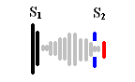

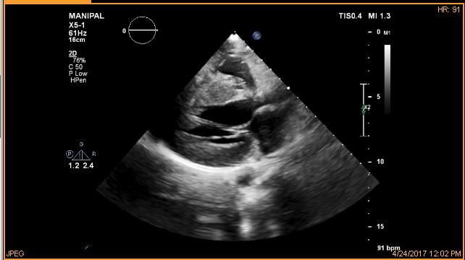
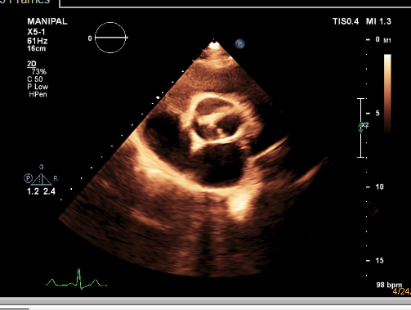
CASE #3
19 Yr F,
7 mo Pregnant
Lady notices “pulsation in neck”
Notes:
Dr maitri

Slide 16
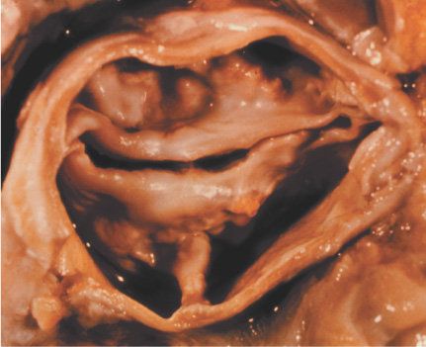
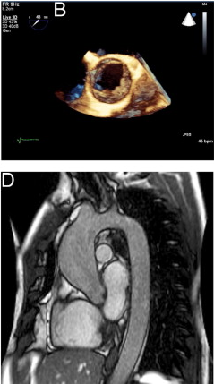
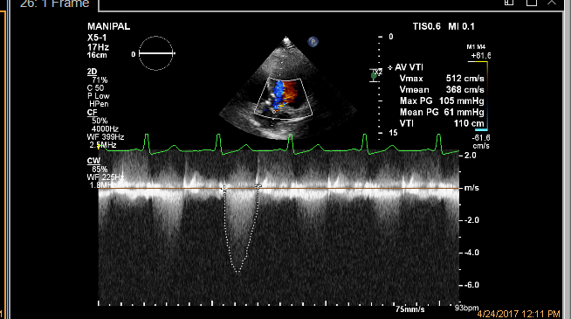
Bicuspid Aortic Valve
Category II : PH due to Left Heart Disease
Identify and Treat The Former, Do Not Chase PAH
Notes:
Dr Munesh : How To Manage The Severe AS in 3rd Trimester of Pregnancy?

Slide 17
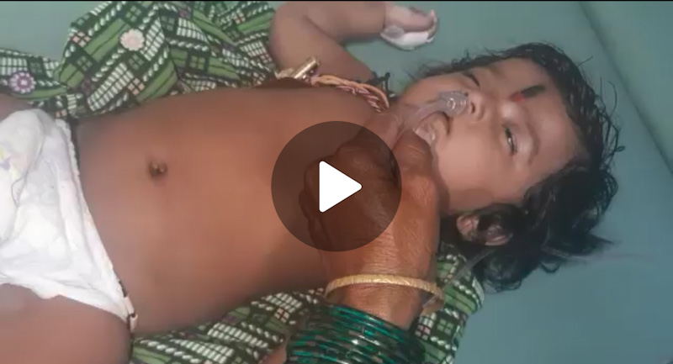
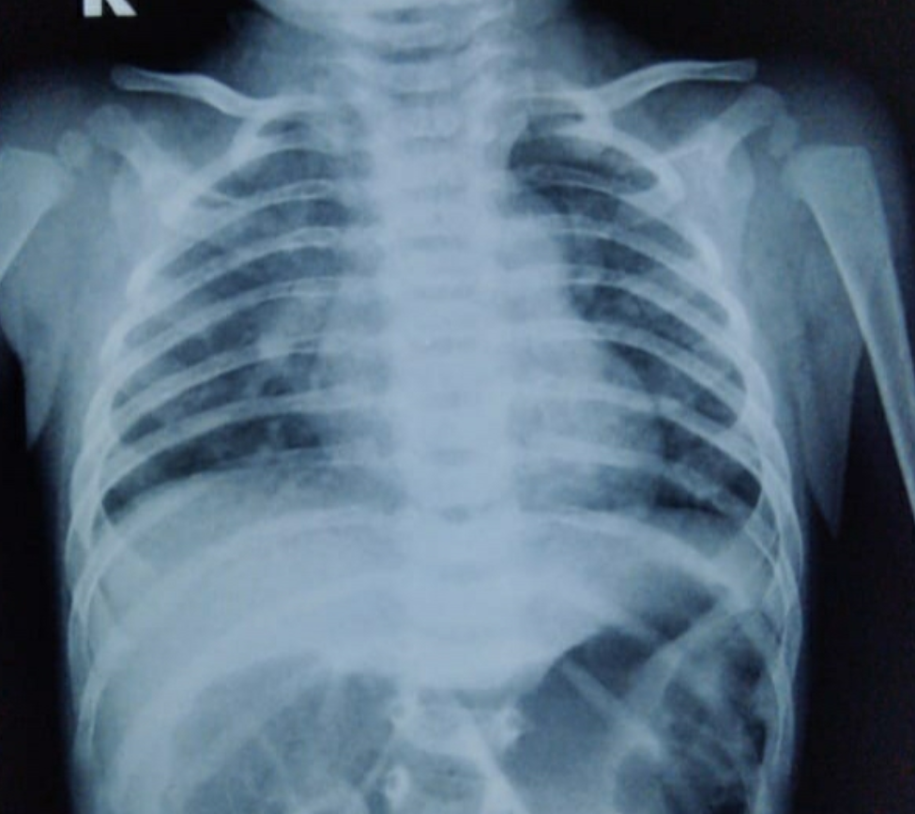
PE: Normal Air entry
crepts/rub/wheeze/stridor nil
Echo : Severe PAH
TR Peak PG =64 mm Hg
No CHD
Lactate 18, PH -7.2, HCO3- 11.5, PCO2 28, Po2 69
CASE #4
Cardiomegaly, Prominent PA
2.5 Mo, 3.8 Kg, Exclusively Breast Fed, Resp. Distress & Crying Episodes X 1 Week,
CHF, Tachycardia, Sats >90%
The Missing Clue: Diet
Rx: IV Thiamine 100 mg/kg till normalization
followed by @2.5-5 mg daily X 4-6 Wks
“Prompt Response To Thiamine Is The Clue”
Notes:
Dr Munesh: How Do You Confirm? What is Your Experience in Wheat Eating Population?

Slide 18
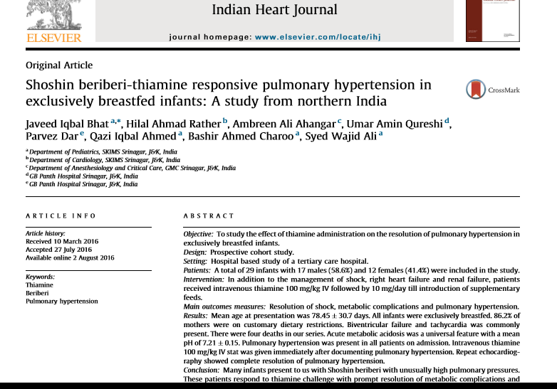
MALNUTRITION CAUSING PAH
Mechanically Milled Rice
Multiple Washing of Rice
Exclusive Rice Eating Mothers
Notes:
Dr Maitri

Slide 19
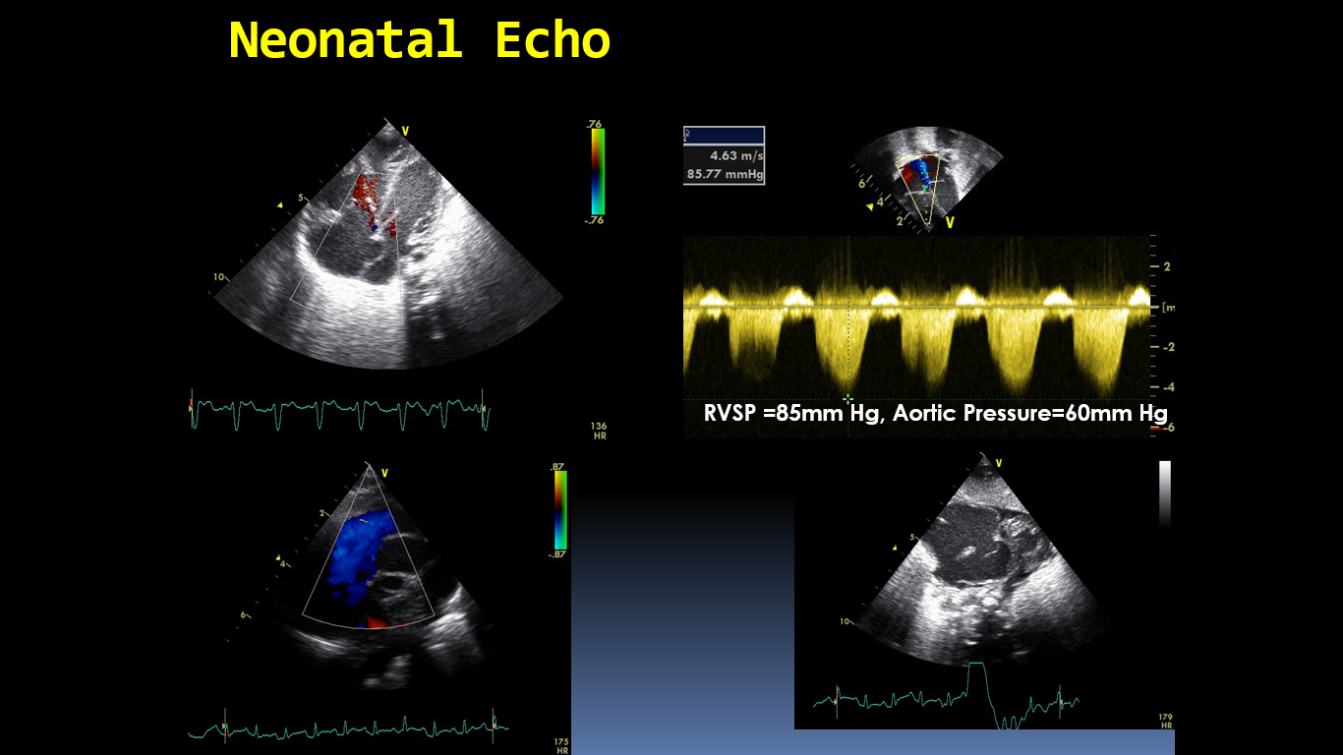
CASE # 5
16 Days Old Neonate
PE: CCF, Sats 85%
Possibilities:
1. Sepsis
2. Duct Dependent lesions
3. IEM
4. ??
SVC
Echo: Severe PAH, But Why?
SVC is Unusually Dilated
No Supracardiac TAPVC
Notes:
Dr maitri: ASD right to left, flow reversal in aorta, severe PAH but look at SVC

Slide 20
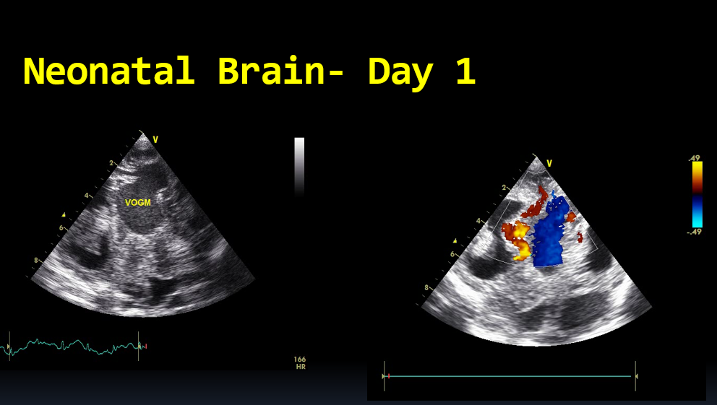
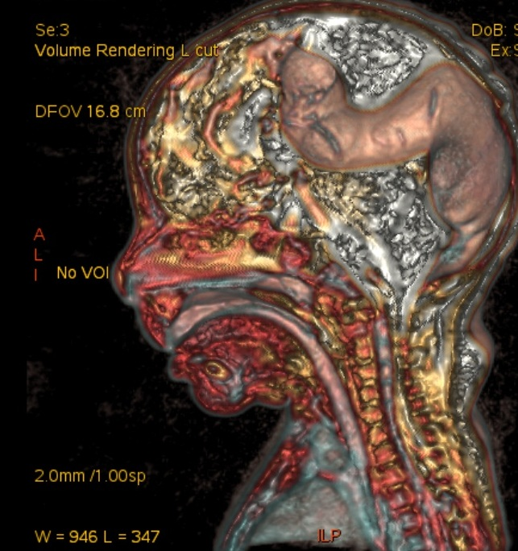
VOGM
VEIN OF GALEN MALFORMATION WITH CCF & PAH
Grp . 5
Rx: Stabilization and Coiling
Extensive Feeders: Radio -ablation
Take Home Message: R/O AV Malformations in Unexplained PH.
Notes:
Dr Maitri

Slide 21
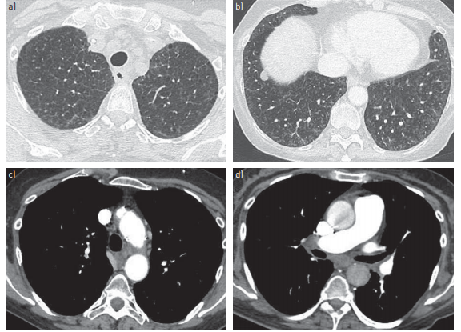
3 Yrs F/ Apparently Doing Well
H/o 2 Syncope While Jumping on Bed
CASE # 6
Pediatric Opinion : ? vasovagal
How To Approach?
Pediatric Exam: Normal
Neuro – Normal
CVS: P2 Loud, Slight Precordial Bulge
ECG – Sinus Rhythm, Normal QTc, RVH +
Echo : OMG >> Severe PAH
Structurally Normal Heart
Mild RV dysfunction
What next:
PFT: FEV1, FVC, TLC Normal
HUTT : Did not do!
Sleep Study : Normal
Pulmonary Vasodilators Started!
HRCT : PVOD
How To Approach?
Notes:
Dr Maitri#3 diagnostic features: Centrilobular ground glass opacity, Prominent Mediastinal Nodes and Thickneing of interlobular septa. Predominantly involves small venules. AR transmission, 1 year mortality 72%. Vasodilators Class III.. Bilateral Lung transplant, immunosuprresive Rx, Supplemental oxygen

Slide 22
PVOD
#3 diagnostic features:
Centrilobular ground glass opacity
Prominent Mediastinal Nodes
Thickening of interlobular septa
Predominantly involves small venules.
Genetic Assessment. EIF2AK4. Autosomal Recessive Transmission.
1-year mortality 72%.
Vasodilators Contra indicated
Management: Bilateral Lung transplant, immunosupresive Rx, Supplemental oxygen & Palliative Care
Notes:
Dr Munesh and Dr Hetal

Slide 23
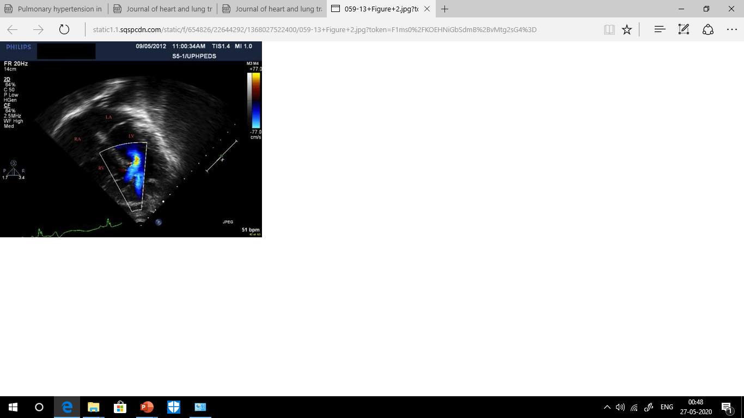
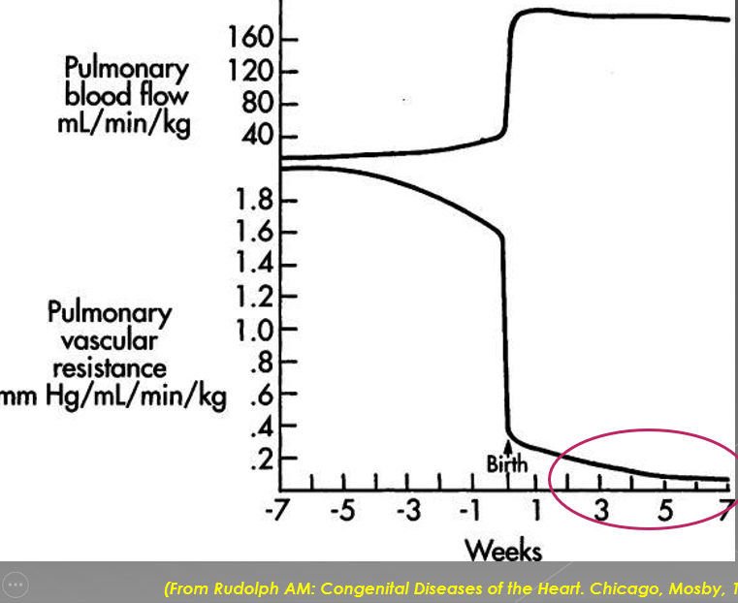
Term Baby, Murmur After 7 Days:
VSD diagnosed , Tachypneic
Frusemide Started Locally
Delay Due to COVID,
Reaches Us at 2 Mo of Age
CASE # 7
Multiple Muscular VSD
Right to Left Shunt Why?
Term Baby, Normal Anomaly Scan
No Antenatal/Perinatal Event
Never in NICU
No Upper/Lower Airway Issues
Clinically not Down’s Phenotype
No other hidden shunts
What is Happening?
Notes:
Dr Maitri

Slide 24

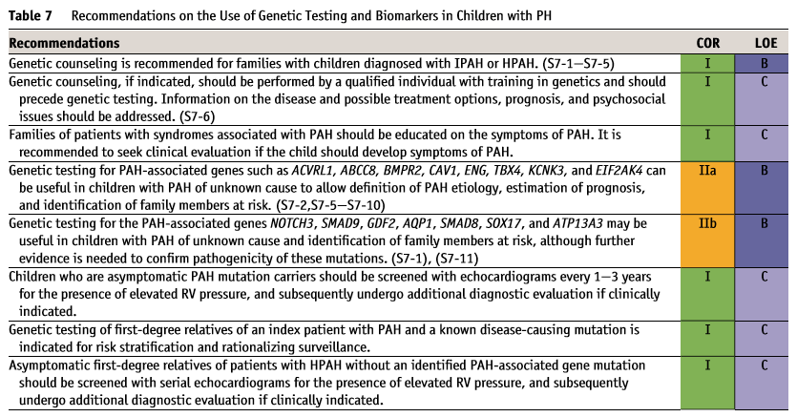
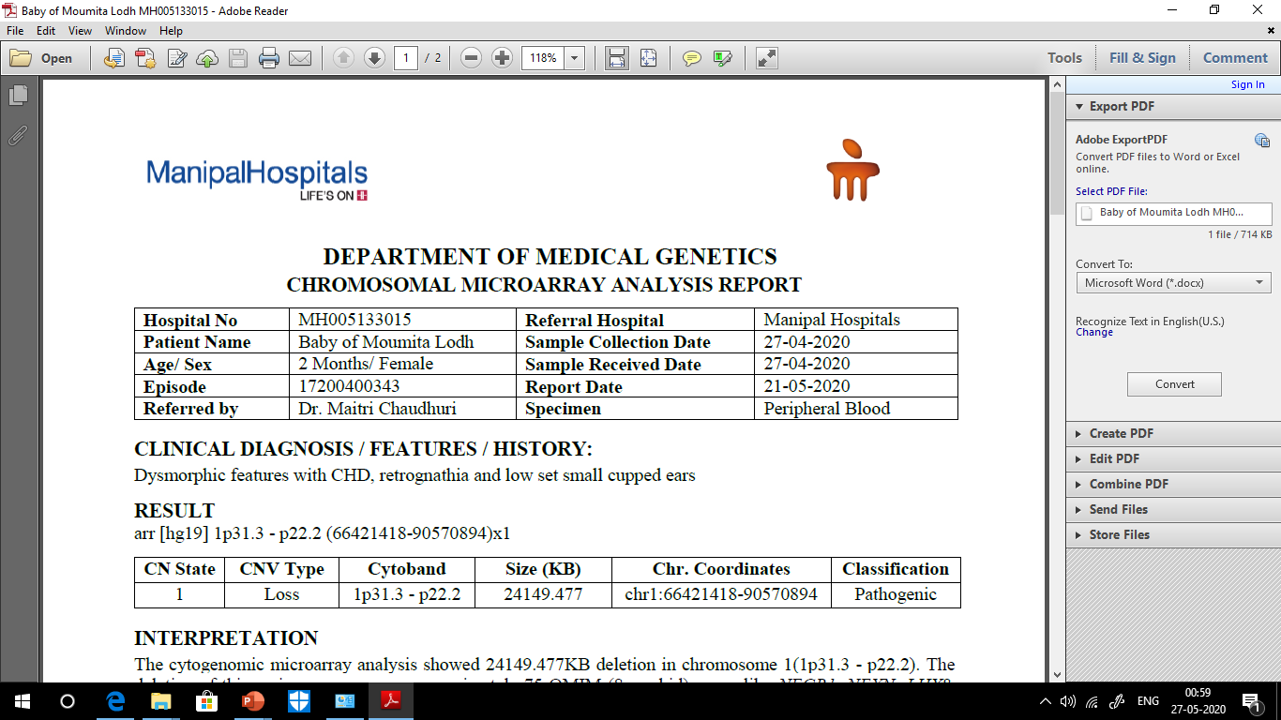
Genetic aetiology : Grp 1. 1.2
25-30% of IPAH are actually heritable PAH
Detailed Genetic counselling required
Notes:
Q. Should We Close VSD and your Rx in this child? Dr Hetal
Q. How To Counsel and FU ? Dr Munesh

Slide 25
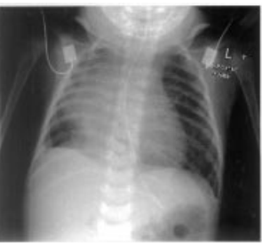
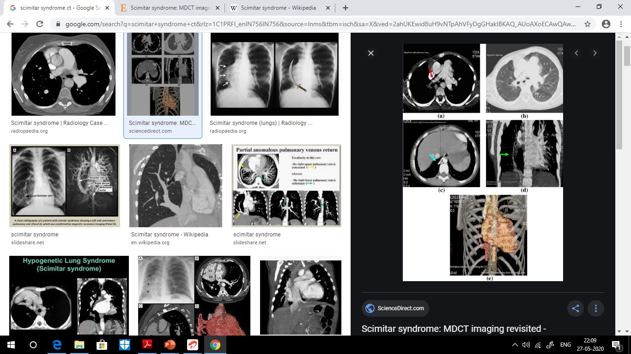
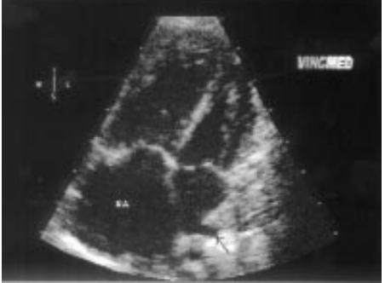
9 Days F/Term/SGA/Admitted with Respiratory Distress, On HFNC Sats =88%, Afebrile, ↓ Air Entry Right Side, ? Heart Sounds More On Right
CASE # 8
Notes:
Dr Maitri

Slide 26
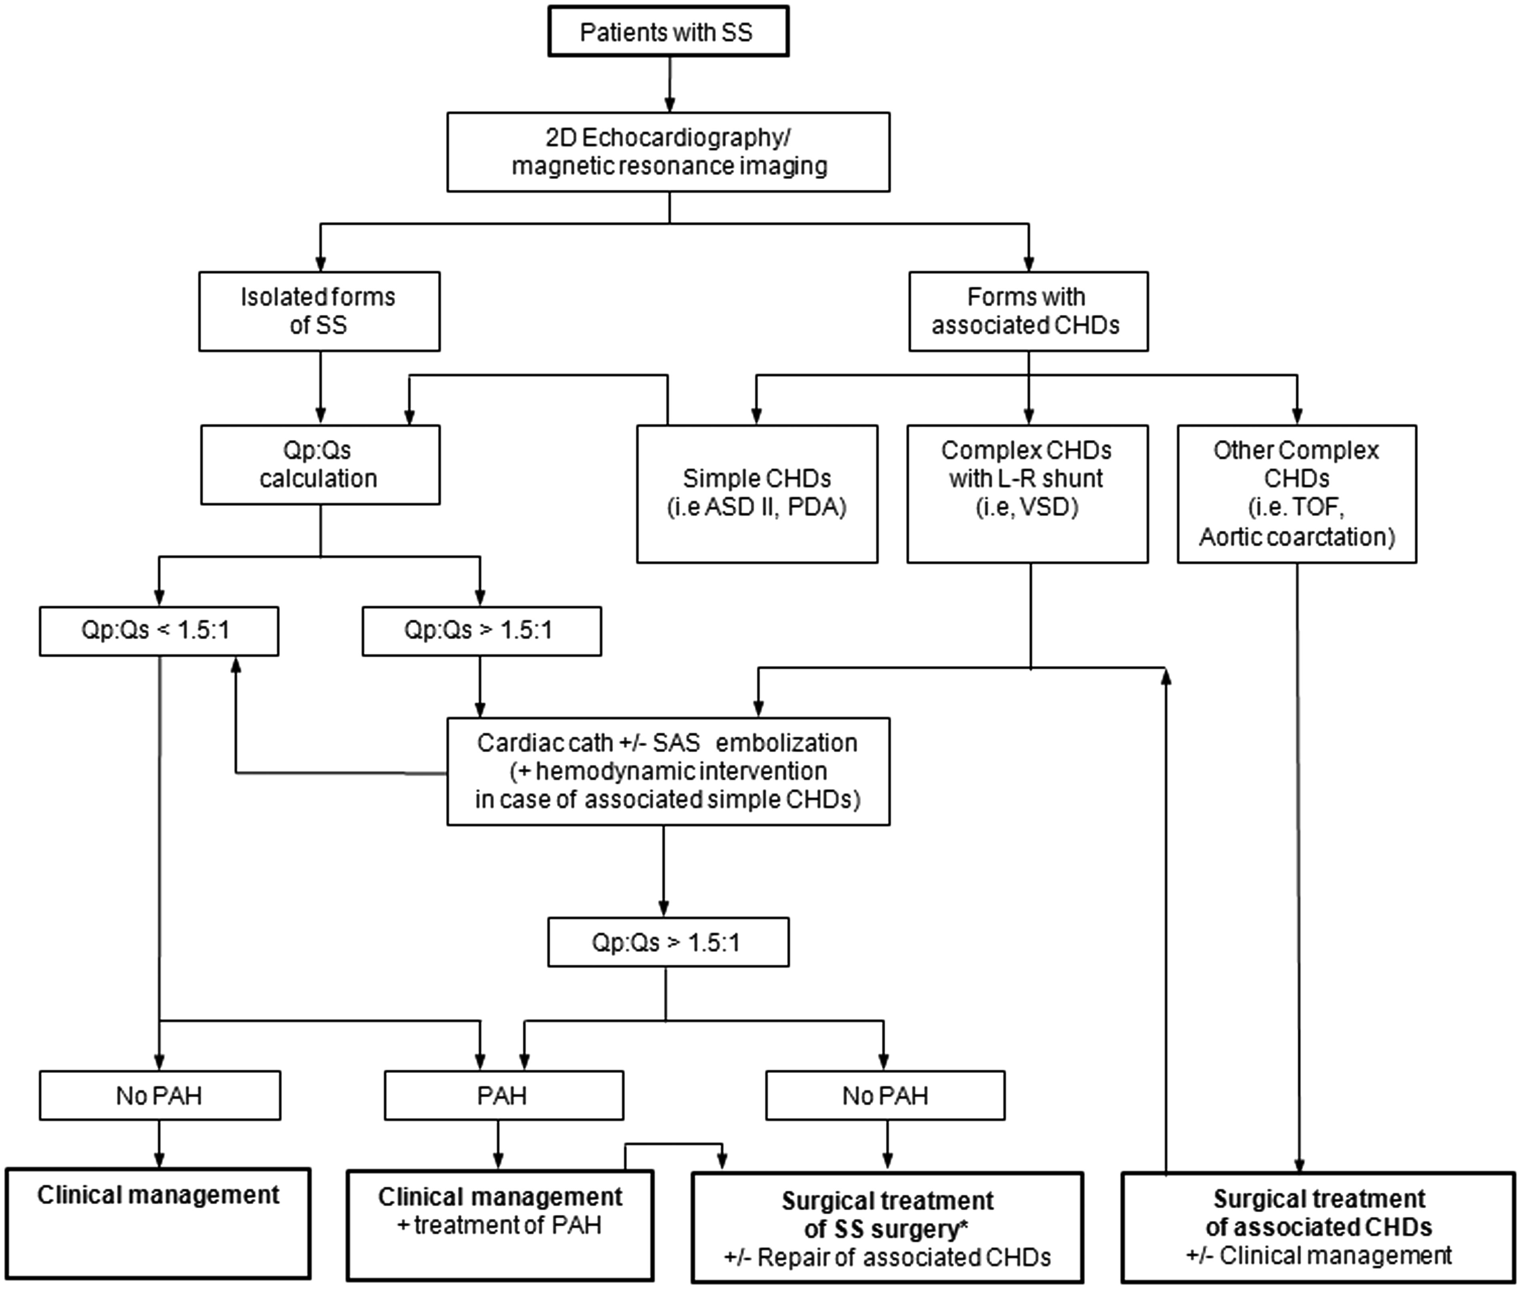
Diagnosis : Scimitar Syndrome
Survival poor in infantile presentation, associated CHD & PAH
Late Stenosis of Pulmonary vein to be looked. Adult survival `80%, Mortality 18.8% infancy
Anomalous venous drainage of part /whole of right lung to IVC
Right lung hypoplasia
Aorto-pulmonary collaterals
Associated CHD
Presentation from neonates> Infants>adolescents>adults
Symptoms: respiratory & cardiac predominant (CCF , PAH)
Notes:
Dr Hetal 1st Part & Dr Munesh :2nd Part

Slide 27
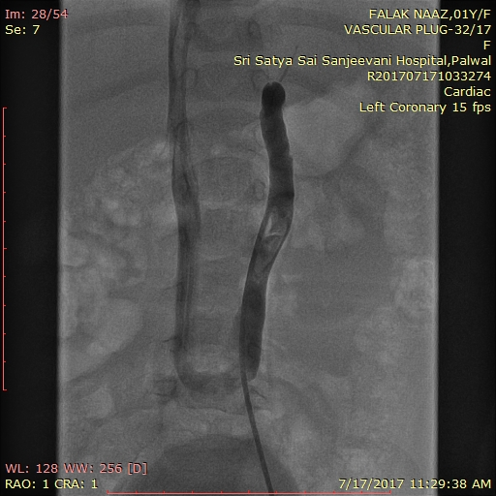
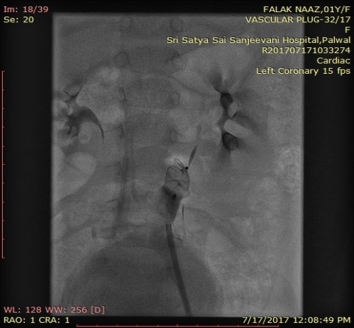
8 month old ,Wt 6 kg
CHF with PAH,cyanosis (SpO2 78%)
Outside echo at 2months of age : VSD R-L shunt
CASE # 9
CXR: cardiomegaly with increased PBF
Repeat echo:
  large Perimembranous VSD+mid muscular VSD, ASD , Dominant R-L shunt, severe PAH,
  “Suspicion of abnormal hepatic venous channel seen “ in subcostal imaging in liver tissue: Also seen in Abdominal Doppler
CT angiography : large Type II Abernathy malformation
12mm Vascular plug was used to successfully close the Venovenous collateral
Abernathy malformation is one of the causes of Hepatopulmonary syndrome.
Notes:
Dr Munesh: Is this PoPH? Schistosomiasis/bilharzia parasitic flatworms/snail fever: From snails/prawns etc. Swimmer’s itch, abdominal pain, bloating, blood in stool and urine. Sildenafil and Praziquantel/Oxamniquine. To be remembered Asia/Africa etc.

Slide 28
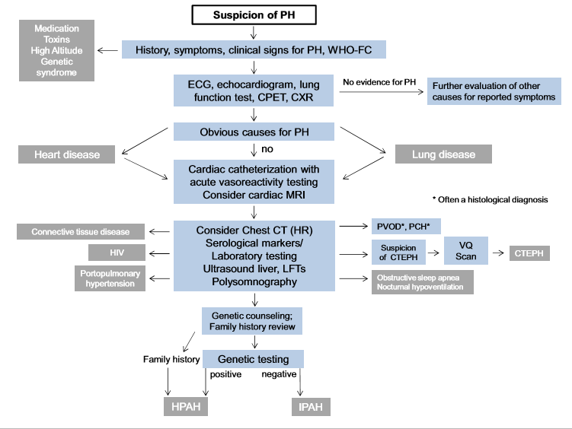
Diagnostic Algorithm in PH
Indian Setup:
How Much Is Possible ?
Journal of Heart and Lung Transplantation, Sep 2019
Notes:
Dr Munesh: Screening for pediatric PH is performed by detailed clinical ,CXR,ECG and echocardiography. If these investigations suggest the presence of PH/PHVD, chest X-ray and/or chest CT should be considered, followed by additional investigations. If PH/PHVD is severe, and the patient presents severely ill in overt heart failure and/or pulmonary vascular crisis, cardiac catheterization may be postponed and pharmacotherapy including intravenous prostanoids started immediately. CPET, cardiopulmonary exercise testing; CT, computed tomography; CTEPH, chronic thromboembolic pulmonary hypertension; CXR, chest X-ray; ECG, electrocardiogram; FC, functional class; HIV, human immunodeﬁciency virus; HPAH, heritable pulmonary arterial hypertension; HR, high resolution; IPAH, idiopathic pulmonary arterial hypertension; LFT, liver function test; MRI, magnetic resonance imaging; PCH, pulmonary capillary hemangiomatosis; PH, pulmonary hypertension; PHVD, pulmonary hypertensive vascular disease; PVOD, pulmonary veno-occlusive disease; VQ, ventilation/perfusion; WHO, World Health Organization. Modiﬁed from Lammers et al., 2016.6 CT : MPA/AAOdiameter ratio ≥1.3 suspect PAH. PA pruning and pulmonary veins.Idiopathic PAH – 3 children per million per year dutch registry

Slide 29
When To Go For Cardiac Catheterization?
Ideally in all
Diagnostic and prognostic implications
  Before start of therapy
  Before change of therapy
  Clinical Worsening
  Before intervention, before transplant
  Assessment of operability
  Repeat cath after 6-12 months on vasodilator
Notes:
Dr Munesh

Slide 30
Should We Stop Pulmonary Vasodilator Drug Before Cath?
  Ideally not . May precipitate symptom
  Local/GA
    GA is high risk for PH patients but smaller /sicker /syndromic baby/ventricular dysfunction/airway issues one need to do under GA
Notes:
Dr Maitri

Slide 31
Cardiac Cath In PH With CHD
Very important and decision should be taken only after detailed clinical evaluation
Basal cath data is very crucial
Diastolic pressure gradient should also be noted
  Studies showing higher DPG with poor long-term outcome
Ideally
  Inhaled NO
  IV sildenafil
  Illoprost(not available in India)
O2 commonly used
  Fallacy :
    Vo2 changes 22-30% with high FiO2 and affecting all calculations
    Dec in CI,stroke volume and Incr in SVR with O2
Clinically borderline operable patients
Cath data should be interpreted very carefully
In doubt: better not to intervene
Notes:
Dr Munesh :CCB in IPAH or HPAH if AVT positive and cardiac function normal. If CCB monotherapy fails, go for sildenafil and combo

Slide 32
Cardiac Cath In PH, No CHD
Cath ideally in all
Dx and prognostic
NO choice
Criteria (modified Barst )
  Decrease in mean PAP >20%
  Increase or no change in Cardiac output
  Dec or No change in Rp/Rs
Stibon criteria
  Decrease in mean PAP >10 ,absolute <40mmHg
  Increase or no change in Cardiac output
UK registery with use of Barst Crt
  Not associated with
    better survival
    Response to CA Blocker
  They found PVRI <4.5 better indicator
Notes:
Dr Munesh

Slide 33
Gold standard of operability
Age
Clinical findings
  CXR/ECG/Echo
Never ignore basal data
Why doing vasodilator testing
  Need to reassess our technique
  Role of Calcium Channel Blocker in Vasoreactivity Test??
Notes:
Dr Munesh

Slide 34
Medical Management of PAH
PART1: General Measures
Oxygen : If Sats <92%, PAo2<60mm Hg, PH + Lung Ds(BPD/CLD etc), in high altitude, during air travel
Diuretics & Digoxin: If documented CCF &/or RV Failure. Caution: ↓ Preload & ↑ PVR may ↓ C.O
OSAS & GERD management if present
Urgent Rx of RTI
Immunizations
Anti-coagulation in IPAH/HPAH/CTEPH, Hypercoagulable states/indwelling IV Port : beware of the risks
IE Prophyaxis: esp. in Cyanotic CHD
Exercise : FC I/II –light to moderate aerobics, FC III/IV/syncope : avoid physical exercises, competitive sports. Keep child Happy!
Reproductive counselling , Remember Teratogenicity Too, Pregnancy Issues
Non cardiac surgery
Notes:
Dr MaitriSpironolactone & Eplerenone useful in adults, no study in children. Thiazides or spironolactone in BPD. Low dose Sildenafil may be given.

Slide 35
Unanticipated PH crisis
Provide PALS
● Administer supplemental oxygen
● Avoid hypercarbia
● Correct metabolic acidosis
● Avoid hypovolemia/provide careful fluid resuscitation
● Administer inhaled nitric oxide
● Provide analgesia/sedation/avoid painful stimuli/strong light/noise
● Support cardiac output with inotropes. Call For Bedside Echo.
● Mechanical support (eg, extracorporeal membrane oxygenation) may be used in some cases
Notes:
Dr Hetal

Slide 36
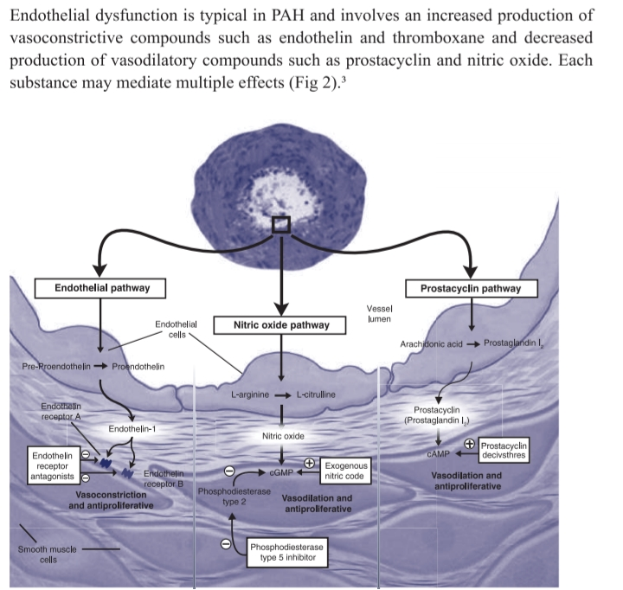

TARGETED PH THERAPY
Achieve
VasoDilatation
Avoid
Vasoconstriction
Notes:
Sildenafil PDE5 inhibitor and increases CGMP. Dose neonates in PPHN 0.5-2mg/kg/dose 8-6 hourly till OI<20. Recruit Lung, IV Magnesium sulphate. Tadalafil 0.5-1mg/kg/day OD, approved over 3 yrs(Circulation guidelines 2015). ERA Bosentan (dual ETA and ETB antagonist)
Starting dose is half the maintenance dose Maintenance dose: Weight <10 kg: 2 mg/kg twice daily orally Weight 10–20 kg: 31.25 mg twice daily Weight >20–40 kg: 62.5 mg twice daily Weight >40 kg: 125 mg twice daily
Monthly LFTs required due to risk for hepatotoxicity HCG and pregnancy test required monthly Incidence of AST/ALT elevation is less in children compared with adults Fluid retention Teratogenicity Male infertility May decrease sildenafil level
COR I LOE B Data have been published on efficacy in Eisenmenger PH 2 Forms of birth control required Drug interaction with sildenafil
ERA Ambrisentan (a highly selective ETA antagonist)
Dose range: 5–10 mg orally daily Use in pediatric patients <5 y of age is unstudied
Routine LFTs recommended HCT and pregnancy test required Incidence of AST/ALT elevation is less in children compared with adults Fluid retention Teratogenicity Male infertility
COR IIa LOE B Safety and efficacy data in children are limited Avoid use in neonates or infant because glucuronidation is not mature
Prostacyclin Epoprostenol (Flolan), Veletri (thermostable)
Continuous intravenous infusion Drug interaction with sildenafil Starting dose: 1–2 ng·kg−1·min−1 IV without a known maximum In pediatric patients, a stable dose is usually between 50 and 80 ng·kg−1·min−1 IV Doses >150 ng·kg−1·min−1 IV have been used Dose increases are required High-output syndrome at high doses can occur
Flushing, jaw, foot and bone pain, headaches, and diarrhea Systemic hypotension is possible Half-life is short (2–5 min), so PH crises occur rapidly if the infusion is stopped Icepack cooling and remixing every 24 h needed Central line complications occur
COR I LOE B Standard therapy for severe PH A temperature-stable formulation is available
Prostacyclin Treprostinil (Remodulin)
Intravenous or subcutaneous: 2 Starting dose: 2 ng·kg−1·min−1 without a known maximum In pediatric patients, a stable dose is usually between 50 and 80 ng·kg−1·min−1 IV or SC Dose increases are required
Inhaled: 1–9 patient-activated breaths every 6 h Oral: dosing not fully evaluated in children
Flushing, muscle pain, headaches, and diarrhea are common side effects Frequency and severity of side effects are less than with epoprostenol Elimination half-life is 4.5 h The drug is stable at room temperature Central line complications can occur, including Gram-negative infections with intravenous route Subcutaneous injection site pain may limit this route Inhaled drug can worsen reactive airway symptoms GI side effects may be greater than with intravenous, subcutaneous, or inhaled
For intravenous and subcutaneous: COR I LOE B
For inhalation: COR IIa LOE B The nebulizer requires patient activation and controlled inhalation limited by age and development
Table 3. Continued
Drug Class Agent Dosing Adverse Effects COR/LOE Comments
(Continued )
Downloaded from http://ahajournals.org by on May 28, 2020
Abman et al Pediatric Pulmonary Hypertension 2045
harm from hemorrhagic complications (Class III; Level of Evidence C). 3. Oxygen therapy is reasonable for hypoxemic PAH patients who have oxygen saturations <92%, especially with associated respiratory disease (Class IIa; Level of Evidence B). 4. Recommendations for calcium channel blockers (CCBs) include the following: a. CCBs should be given only to those patients who are reactive as assessed by AVT and >1 year of age (Class I; Level of Evidence C). b. CCBs are contraindicated in children who have not undergone or are nonresponsive to AVT and in patients with right-sided heart dysfunction owing to the potential for negative inotropic effects of CCB therapy (Class III; Level of Evidence C). 5. Oral PAH-targeted therapy in children with lowerrisk PAH is recommended and should include either a phosphodiesterase type 5 (PDE5) inhibitor or an endothelin (ET) receptor antagonist (ERA) (Class I; Level of Evidence B). 6. A goal-targeted therapy approach in which PAHspecific drugs are added progressively to achieve specified therapeutic targets can be useful (Class IIa; Level of Evidence C). 7. Intravenous and subcutaneous PGI2 or its analogs should be initiated without delay for patients with higher-risk PAH (Class I; Level of Evidence B). 8. Recommendations for the transition from parenteral to oral or inhaled therapy include the following: a. This transition may be considered in asymptomatic children with PAH who have demonstrated sustained, near-normal pulmonary hemodynamics (Class IIb; Level of Evidence C). b. The transition requires close monitoring in an experienced pediatric PH center (Class I; Level of Evidence B). Idiopathic PAH
1. Lung biopsy may be considered for children with PAH suspected of having PVOD, pulmonary capillary hemangiomatosis, or vasculitis (Class IIb; Level of Evidence C).
2. Referral to lung transplantation centers for evaluation is recommended for patients who are in World Health Organization (WHO) functional class III or IV on optimized medical therapy or who have rapidly progressive disease (Class I; Level of Evidence A). 3. Referral to a lung transplantation center for evaluation is recommended for patients who have confirmed pulmonary capillary hemangiomatosis or PVOD (Class I; Level of Evidence B).
Pediatric Heart Disease
1. In children with significant structural heart disease (ie, atrial septal defect [ASD], ventricular septal defect [VSD], and patent ductus arteriosus [PDA]) who have not undergone early repair (as generally defined as by 1 to 2 years of age, depending on the lesion and overall clinical status), the following are recommended: a. Cardiac catheterization should be considered to measure PVR index (PVRI) and to determine operability (Class II; Level of Evidence B). b. Repair should be considered if PVRI is <6 Wood units (WU)·m2 or PVR/SVR <0.3 at baseline (Class I; Level of Evidence B). 2. In children with evidence of right-to-left shunting and cardiac catheterization revealing a PVRI ≥6 WU·m2 or PVR/SVR ≥0.3, repair can be beneficial if AVT reveals reversibility of PAH (absolute PVRI <6 WU·m2 and PVR/SVR <0.3) (Class IIa; Level of Evidence C). 3. If cardiac catheterization reveals a PVRI ≥6 WU·m2 or PVR/SVR ≥0.3 and minimal responsiveness to AVT, the following are recommended: a. Repair is not indicated (Class III; Level of Evidence A). b. It is reasonable to implement PAH-targeted therapy followed by repeat catheterization with AVT after 4 to 6 months and to consider repair if the PVRI is <6 WU (Class IIb; Level of Evidence C). PH Crises/Acute RV Failure
1. General postoperative strategies for avoiding PH crises (PHCs), including avoidance of hypoxia,
Prostacyclin Iloprost (intermittent inhalation)
Pediatric dosing has not been determined but 6–9 inhalations per day are required, each lasting 10–15 min Start with 2.5-µg dose and uptitrate to 5-µg dose as tolerated
Flushing and headaches are common side effects Systemic hypotension is rare. Half-life is short Inhaled drug can worsen reactive airway symptoms

Slide 37
For Practising Clinicians
GROUP A
Inhaled Iloprost
Intravenous Epoprostenol
Subcutaneous & Oral Treprostinil
Sildenafil
Bosentan
Combo of 2
Occasionally Ambrisentan
Occasionally Tadalafil
Combo of Above
GROUP C
Approved in pediatrics, Not Available in India
GROUP B
GROUP D
Not Approved in pediatrics, Available in India
Macitentan
Riociguat
Selexipag
Notes:
IV Epoprostenol t1/2 =3-5 minutes. Rebound PAH, nausea, diarrhea, bone pain, headache, jaw pain, myalgia. Trepostinil loner T1/2. Iloprost nebs 6-9 times per day.

Slide 38
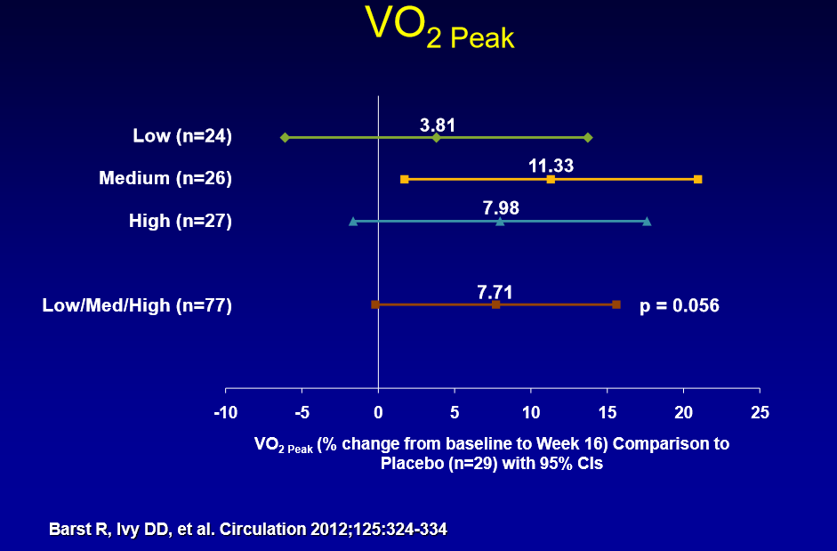
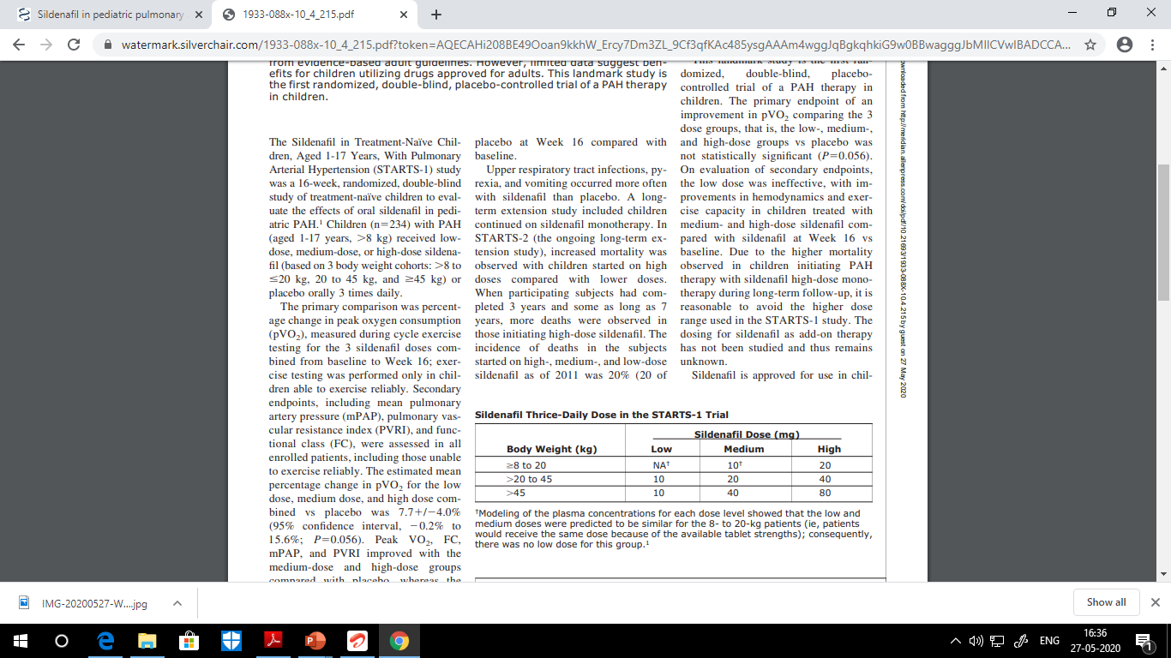
HOW SAFE IS SILDENAFIL IN PEDIATRICS?
STARTS TRIALS 1 & 2
(Sildenafil in Treatment Naïve Children , Aged 1-17 Years in PAH
N=234, Primary Endpoint : ↑ in Peak O2 Consumption at 16 wks
Low Dose As Good As Placebo
10.2% increase in Primary End Point. 2ndary End Points like FC and Hemodynamics also improved.
STARTS 2 : Further FU for 3-7 years :-
More Complications & Mortality in Higher Doses(20%)
Cautioned by US FDA, Europe: Depends on severity at baseline and etiology of PAH
Message: Use Judiciously, Monitor and Know when to Stop!
Notes:
STARTS 2 prolonged by 3-7 yrs. 100), 14% (10 of 74), and 9% (5 of 55), respectively. Deaths in the STARTS-2 extension study were related to PAH etiology and baseline disease severity. The majority of deaths occurred in patients with idiopathic PAH/familial PAH as compared with PAH associated with congenital heart disease patients. Of patients who died, most had baseline values above median values for PVRI, mPAP, and right atrial pressure

Slide 39
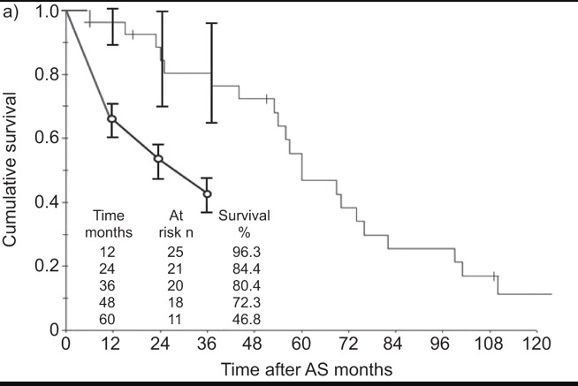
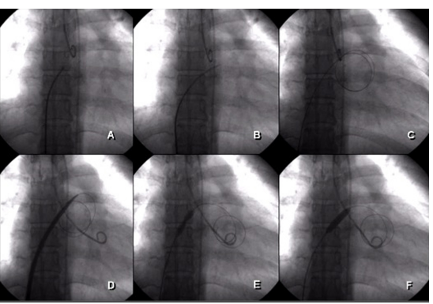
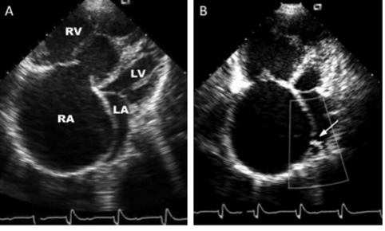
IF PAH IS REFRACTORY TO MEDICINES:
IS THERE A WAY AHEAD?
Balloon Atrial Septostomy
Notes:
Contraindications: Baseline mean RAP>20mm Hg, Sats <90% PVRI>55 WU/m2, Expected 1 year survival <40%. Explanation: Dr Munesh.

Slide 40


Reverse Pott’s Shunt Only if Suprasystemic PAH
Notes:
Dr Munesh: If patient has RV dysfunction, shall it work?

Slide 41
General Follow Up
Most patients every three to six months
More frequent visits for patients with severe disease and after therapeutic changes
Follow-up visits:
  assess symptoms & signs of right heart failure
  exercise tolerance(6 minutes walk test)
  BNP level at each visit(corelate well with NYHA class)
  medication side effects &dose adjustments
  echocardiogram.
  Repeat cardiac catheterization is generally recommended within 3 to 12 months after starting therapy or with clinical deterioration .
Notes:
Dr Hetal

Slide 42
Take Home Clinical Message :
From Syncope/Cyanosis/ Growth failure,
Children manifest very differently in each PAH case
Thorough Head to Toe Examination Must, Think and Think.
ECG, CXR and ECHO are first investigations
Echo provides a rapid non invasive estimation of PAH, Excludes CHD, Assesses Severity & Prognosticates
Other investigations to be Tailor Made for the Child
Right Heart Cardiac Cath is The Gold Standard,but in samll babies sometimes you need to start medication without cardiac cath
Notes:
Dr Hetal/Maitri

Slide 43
KINDLY REMEMBER
In all PH:you don’t need vasodilators
Always try to rule out treatable causes because IPAH has guarded prognosis in pediatric age group
Don’t start pulmonary vasodilator empirically
  Detailed work up is must
Few Medications Available, Know Which to Use or Not Use.
It’s a Teamwork, Phone a Friend ! YES WE CAN!
Notes:
Dr Munesh

Slide 44

Stay Safe, Happy & Communicate Empathy in this Communicable World!

Slide 45


